Slide 1
Digital Image Processing
Project
Project Topic :
Fast O(1) Bilateral Filter using Trigonometric Range kernels.

Slide 2
Team : Full Marks
Team Members :
Sreeharsha TD (2020102040)
Nikhil Agarwal (2020102021)
Atharv Sujlegaonkar (2020102025)
Mitul Garg (2020102026)
Mentor TA : Manasvi Vaidyula
Repo URL : Link

Slide 3
About the topic
We know that the edge-preserving bilateral filter involves an additional range kernel along with the spatial filter. This is used to restrict the averaging to those neighborhood pixels whose intensity are similar or close to that of the pixel of interest. The range kernel operates by acting on the pixel intensities. This makes the averaging process nonlinear and computationally intensive, particularly when the spatial filter is large. In this paper, we show how the Bilateral Filter can be implemented in O(1) time complexity using trigonometric range kernels.
This means on changing kernel size change in the time of computation will be negligible.

Slide 4
Motivation
The idea of using trigonometric range kernels was inspired from the Constant time Bilateral Filter using Polynomial Kernels presented by Porikli . The class of trigonometric kernels turns out to be sufficiently rich, allowing for the approximation of the standard Gaussian bilateral filter more efficiently. The attractive feature of this approach is that, for a fixed number of terms, the quality of approximation achieved using trigonometric kernels is much superior to that obtained by Porikli using polynomials.

Slide 5
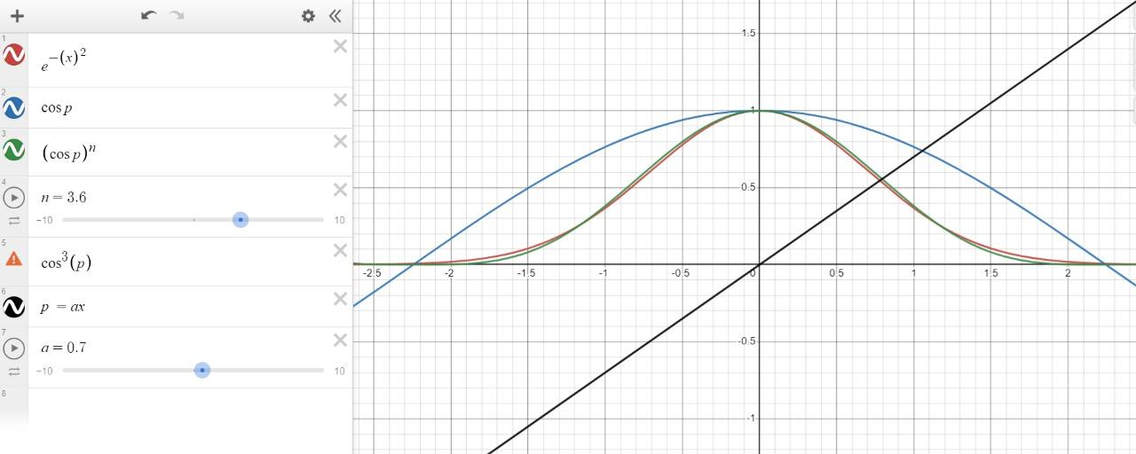
Example : Approximation using Cosines using nearly 4 terms

Slide 6
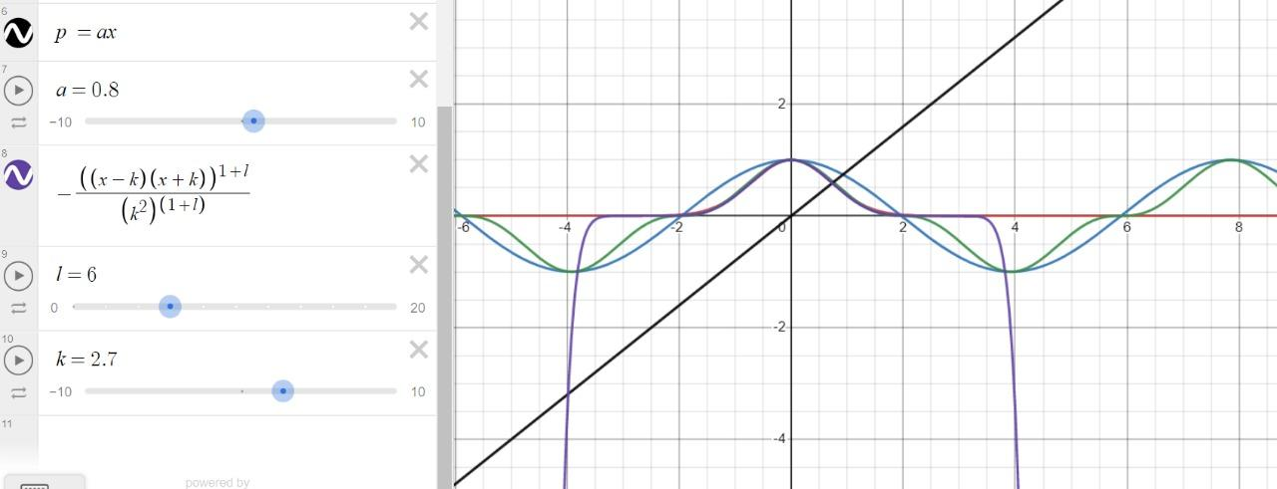
Example : Approximation using Polynomial using nearly 14 terms

Slide 7


The Bilateral Filter
The Bilateral Filter of am image f(x) is given by :
Where w(x) is the spatial kernel and ∅(s) is the range kernel

Slide 8
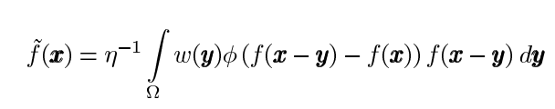
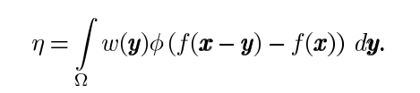
Unbiased form of the Bilateral Filter
Using w(x,y) = w(x-y) and ∅(f(x),f(y)) = ∅(f(x) - f(y))
`f(x) is given by :
where

Slide 9
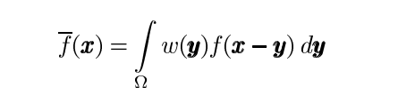
Constant Time Bilateral Filter
The presence of ∅(f(x-y) - f(x)) in the following equation makes the filter non-linear.
In the absence of this term the filter is simply :
which can be calculated in constant time using convolution multiplication property of the FFT. Here the constant time is being referred in respect to kernel size, but the computations will depend on the size of the image. We assume that :
∅(s) = cos(ɣs) (-T <= s <= T)

Slide 10

We use this assumption in our unbiased bilateral filter equation :
Here we can interpret it as averaging done on images cos(ɣf(x)) and sin(ɣf(x))

Slide 11

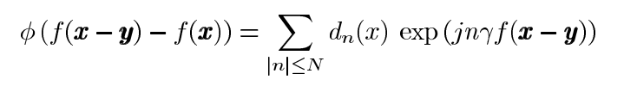
Role of Geometric Range Kernels
The aforementioned idea can be easily extended to more general trigonometric functions. This is most conveniently done by writing in terms of complex exponentials, namely
Coefficients Cn must be real and symmetric since is real and symmetric. Now, using the addition–multiplication property of exponentials :

Slide 12

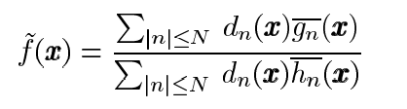
Here,
Substituting it into the unbiased bilateral filter equation we get :
where

Slide 13
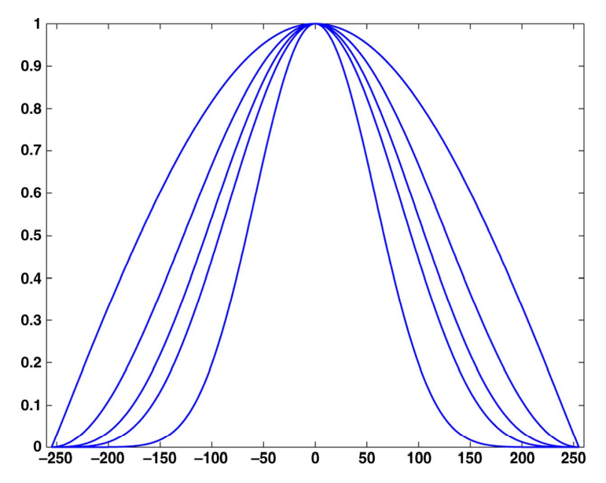
Raised Cosines
We use the advantage of the symmetricity and monotonicity of Powers of Cosines called Raised Cosines. Here are few of them where we observed that higher cosines tend to approximate towards a Gaussian curve and start deviating after a given value K, after which the graph starts to deviate from Gaussian Curve. In the example figure , our n values range from 1 to 5.
n = 1
n=5

Slide 14


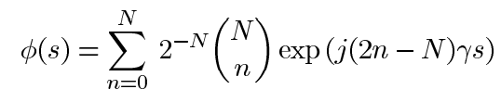
Equations
Denoting our range kernel as a raised cosine (approximation)
We know that
Applying Binomial theorem on the above expression , we get:

Slide 15
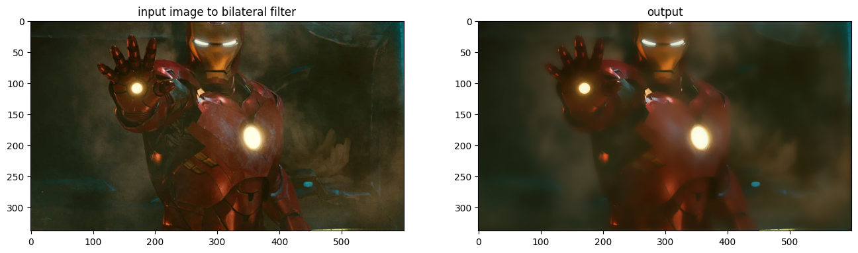
Results

Slide 16
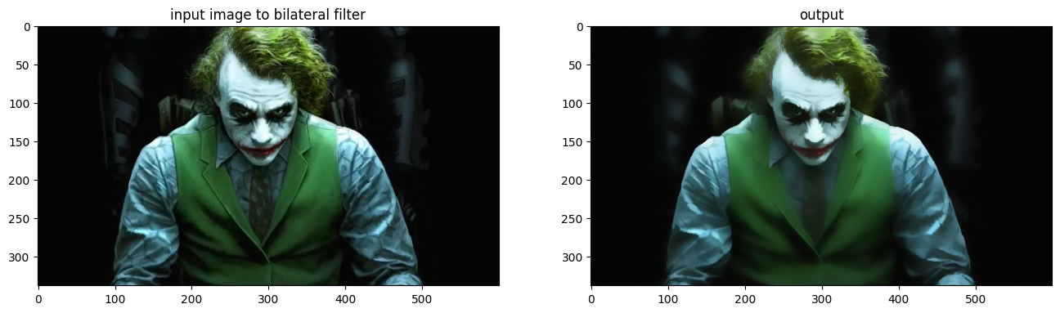
Results

Slide 17
Work Distribution
Mitul : Paper Reading, Implementation, PPT, Documentation, Fast bilateral kernel, Fast Filter for Spatial Kernel
Sreeharsha : Paper Reading, Implementation, Maximum Local Range Function, Apply filter, Fast bilateral kernel, Time comparison Analysis
Nikhil : Paper Reading, Implementation, Fast bilateral kernel, requirements.txt
Atharv : Paper Reading, Implementation, Gaussian Kernel, Apply Filter FFt, Fast bilateral kernel

